Slide 1


Antonio Gálvez
Adrian Ballesteros
Ivan Dominguez
DAW
Josep Queralt

Slide 2
Index
Introduction
Idea description
Initial technical objectives
Company proposal
Development
Analysis
Design
Demo/video
Conclusion
Technical objectives achieved / not achieved / extended
Possible future extensions
Personal assessment

Slide 3
Idea description
The main idea is to make a web page where users can read and answer the dilemmas created by the web administrator.

Slide 4
Initial technical objectives
Create an information website with dynamic style.
Functional website on mobile and tablets.
Create questions and be able to answer them, saving them in a database.
The administrator can create new "Dilemmas".
Possibility of modifying and eliminating the "Dilemmas" created.
Registration for users of Secondary and University, only with mail from the educational center.

Slide 5
Company proposal
The project covers a very specific need where the client wants to collect information on a series of “Technoethical Dilemmas” in order to do a later doctoral study.

Slide 6
Analysis
Functional and non-functional requirements
Login and User Registration
Creation, modification and elimination of Dilemmas
Consult and download the answers of the Dilemma you want.
Used technology
NetBeans
GitLab
Visual Studio Code
Vagrant

Slide 7
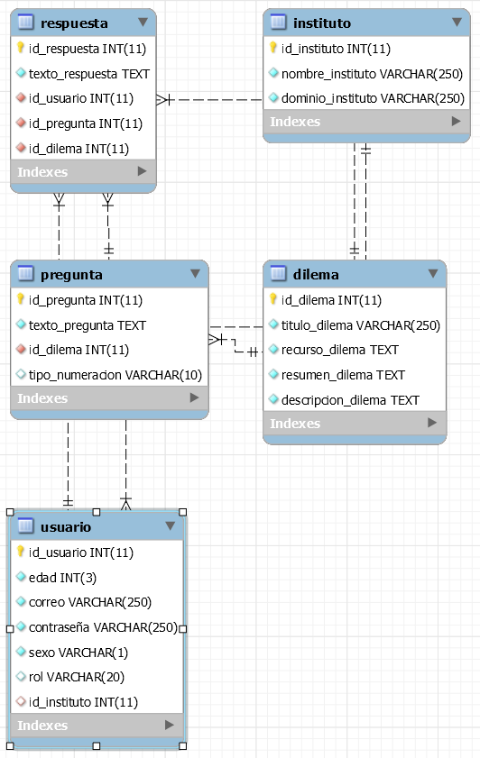
Design
Database

Slide 8
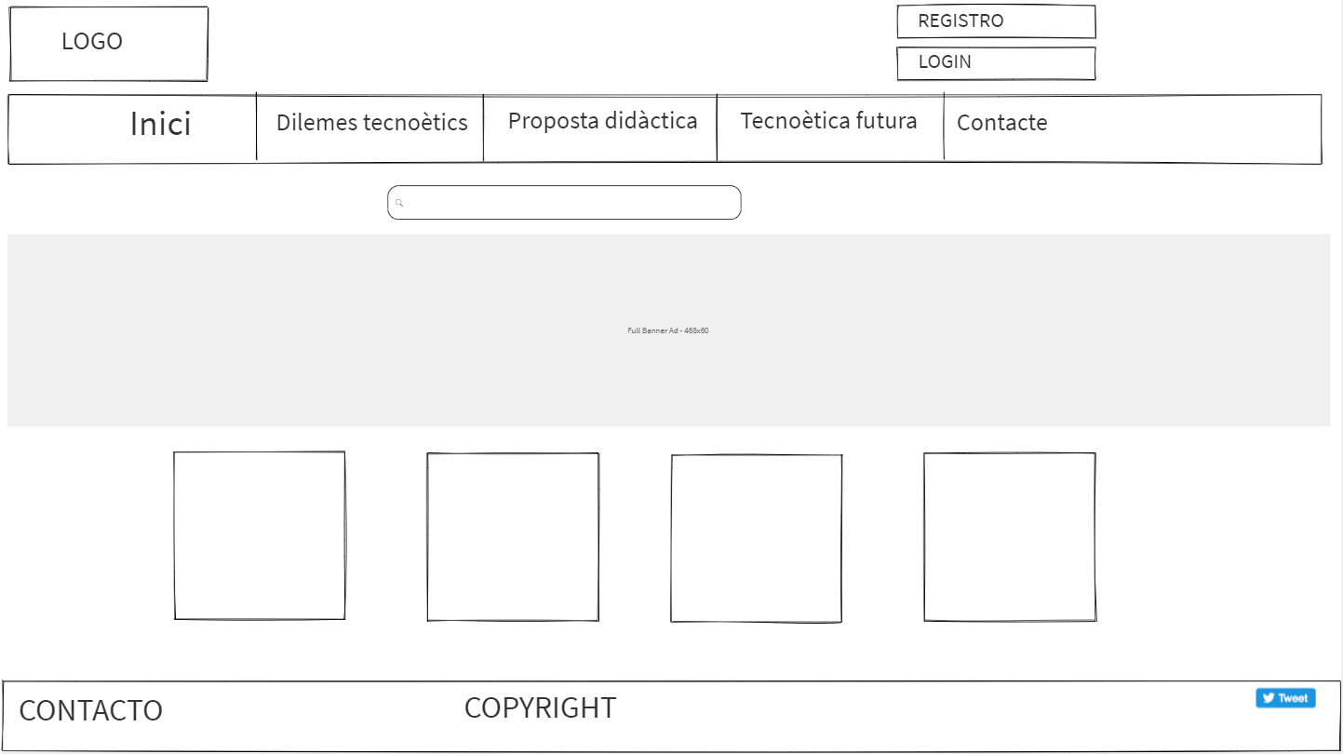
Design

Slide 9
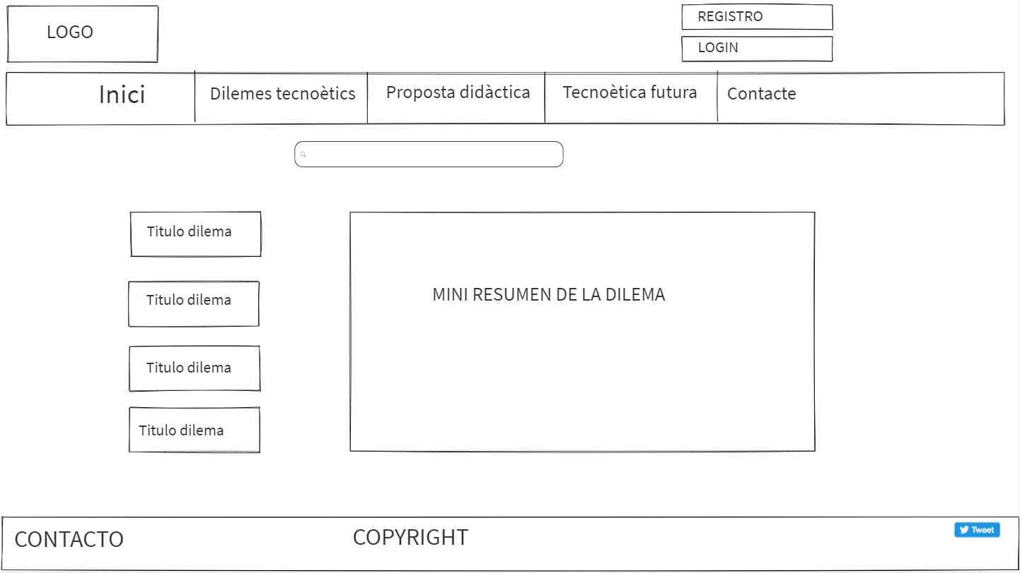
Design

Slide 10
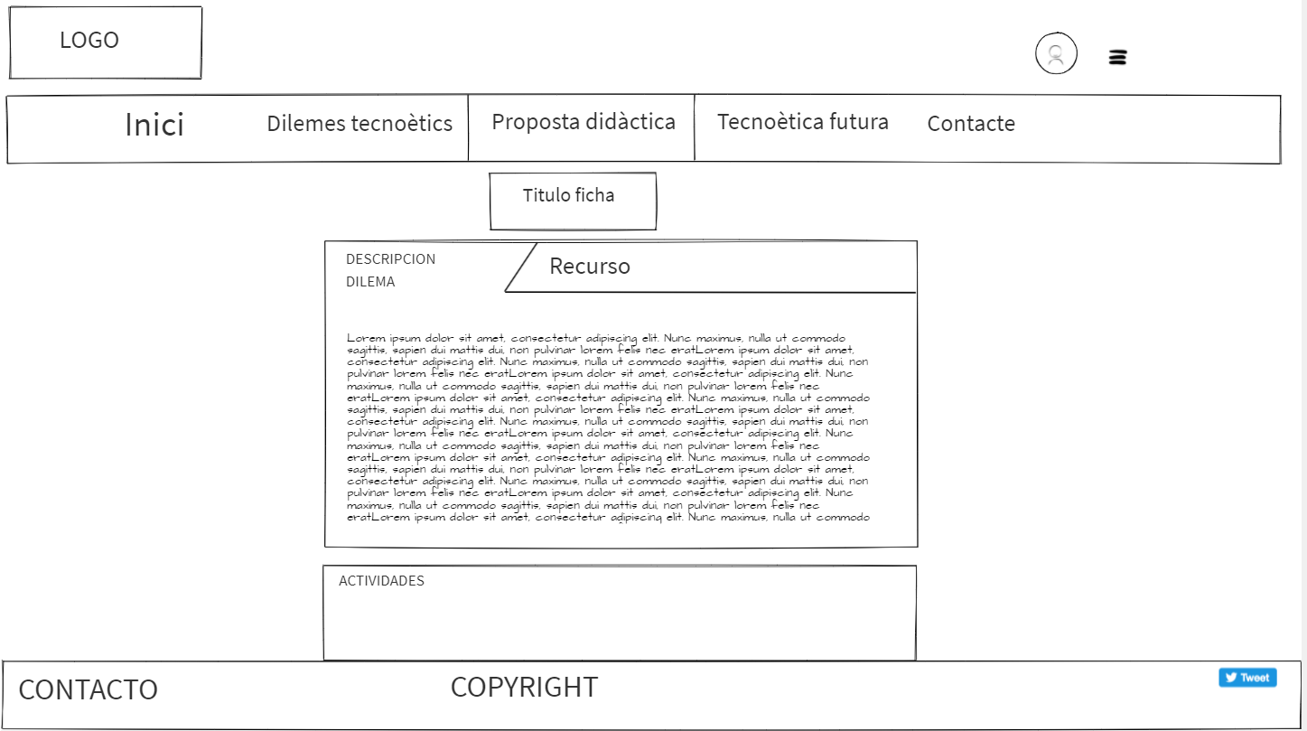
Design

Slide 11
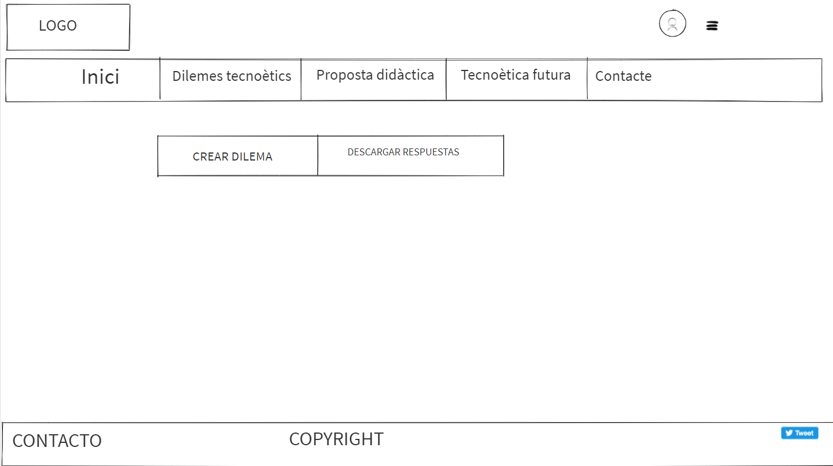
Design

Slide 12
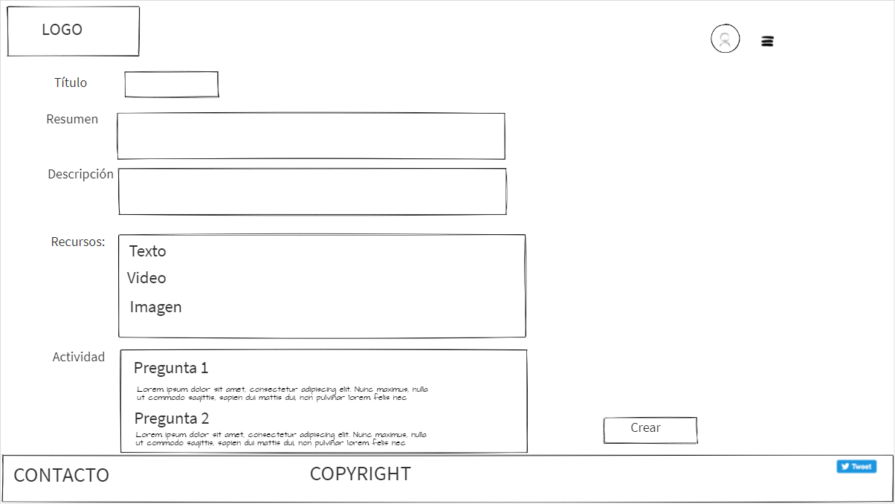
Design

Slide 13
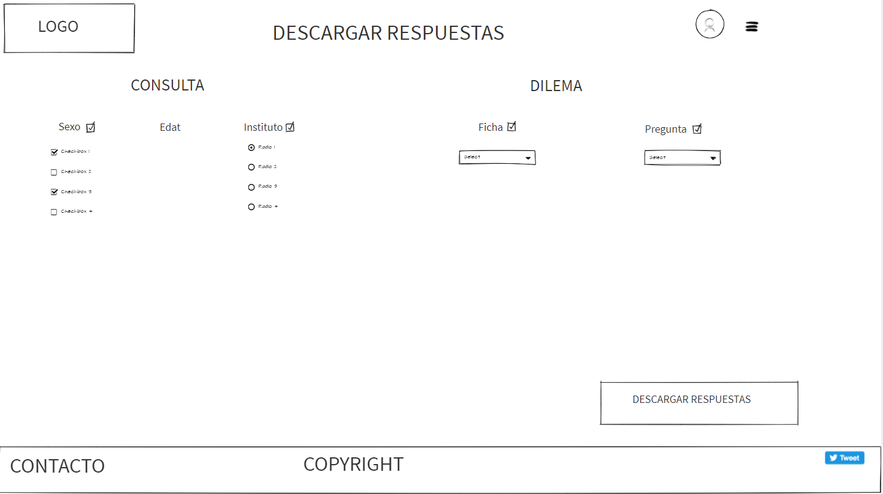
Design

Slide 14
Demo/video
LINK TO VIDEO:

Slide 15
Technical objectives achieved / not achieved / extended
Achieved:
Login and User Registration
Creation Dilemmas
Consult and download the answers of the Dilemma you want.
Not achieved:
Modification and elimination of Dilemmas
Extended:
Nothing

Slide 16
Possible future extensions
That the user review the dilemmas they have made.
Solve the problems we have had with accents in the database.

